Slide 1



HEALTHY LIFESTYLE

Slide 2
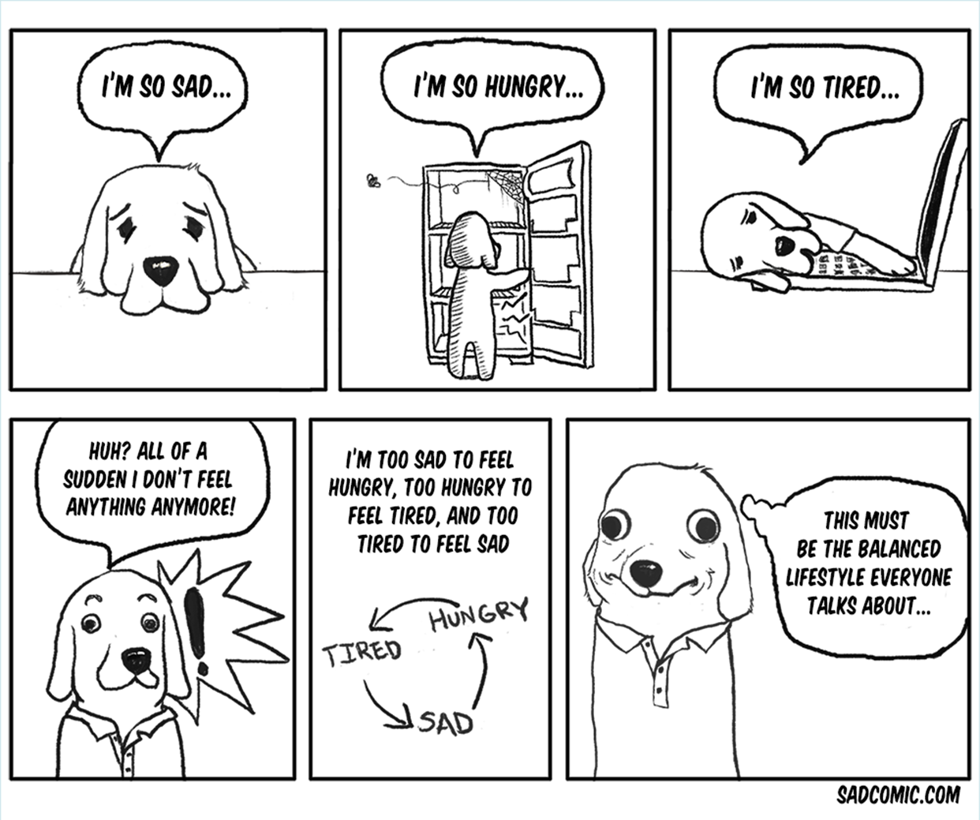

Slide 3
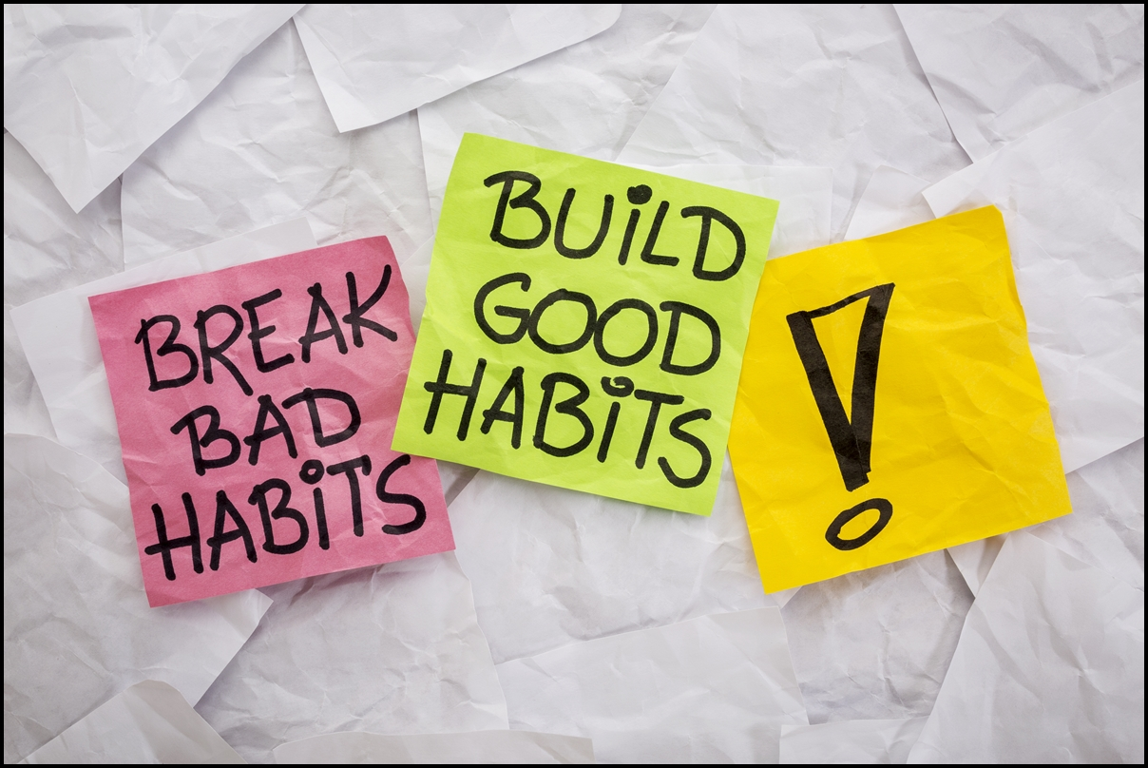

Slide 4
BREAK BAD HABITS!
Smoking and drugs – QUIT
Alcohol, sugar, caffeine or junk food – once in a while is OK
Don’t stop at once – quitting gradually is better for your body and your mind – and also – it’s doable
Don’t make too many changes at once – your motivation will drop soon

Slide 5


Slide 6
GO TO REGULAR CHECKUPS
You should know what your body feels like when everything is all right to notice when it’s not
If you want to make changes in your lifestyle, it’s better to be sure you’re not missing anything – minerals, vitamins – so you don’t actually make your health worse

Slide 7


Slide 8
SLEEP
Sleep for at least 8 hours
Go to sleep before midnight – sleeping till noon will not help
Don’t underestimate the power of a good night’s sleep
Sleep on your back so it doesn’t hurt

Slide 9
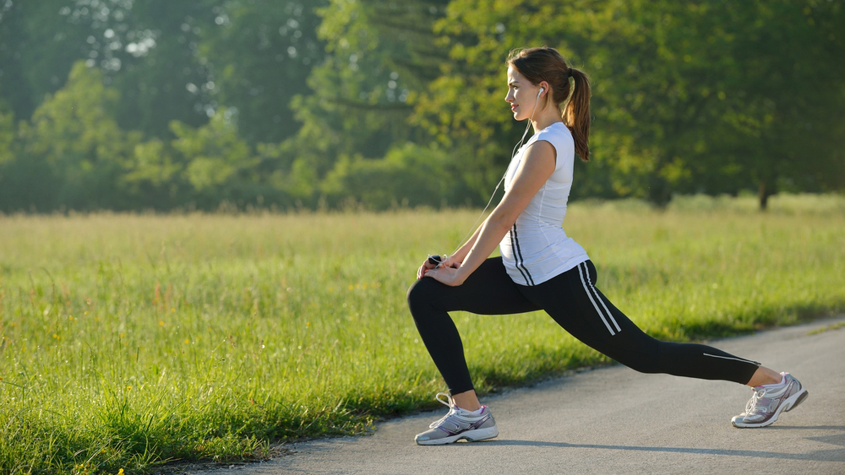

Slide 10
EXERCISE
It makes your heart and lungs stronger
It brings more oxygen to your brain – more energy, better thinking, better mood!
It strengthens your muscles – you feel good and you are less likely to get injured
It improves your posture – you look better and all your organs can work the way they should
Because of various chemicals in your brain, it just makes you feel happy! (endorphins)
Regular exercise can help with depression

Slide 11
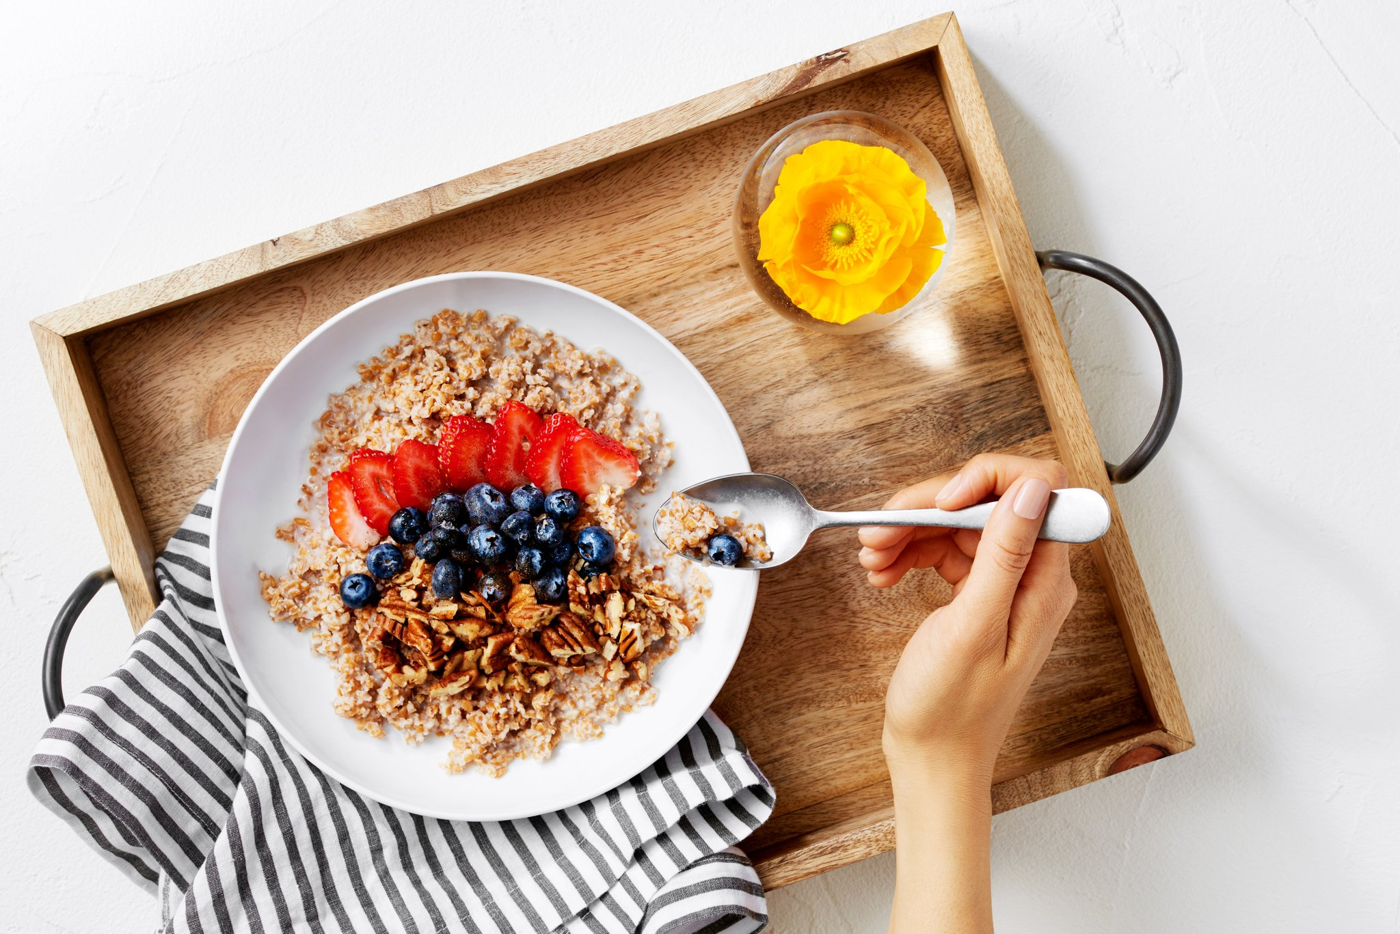

Slide 12
EATING BREAKFAST
First meal after 8 hours without any food or drinks
Gives you energy – to your body to go out and face the day, and to your brain to make healthy and better choices
If you don’t eat breakfast, your body will get hungry soon and your brain will crave things that give you instant energy – sweets, junk food = you get more calories in your system

Slide 13
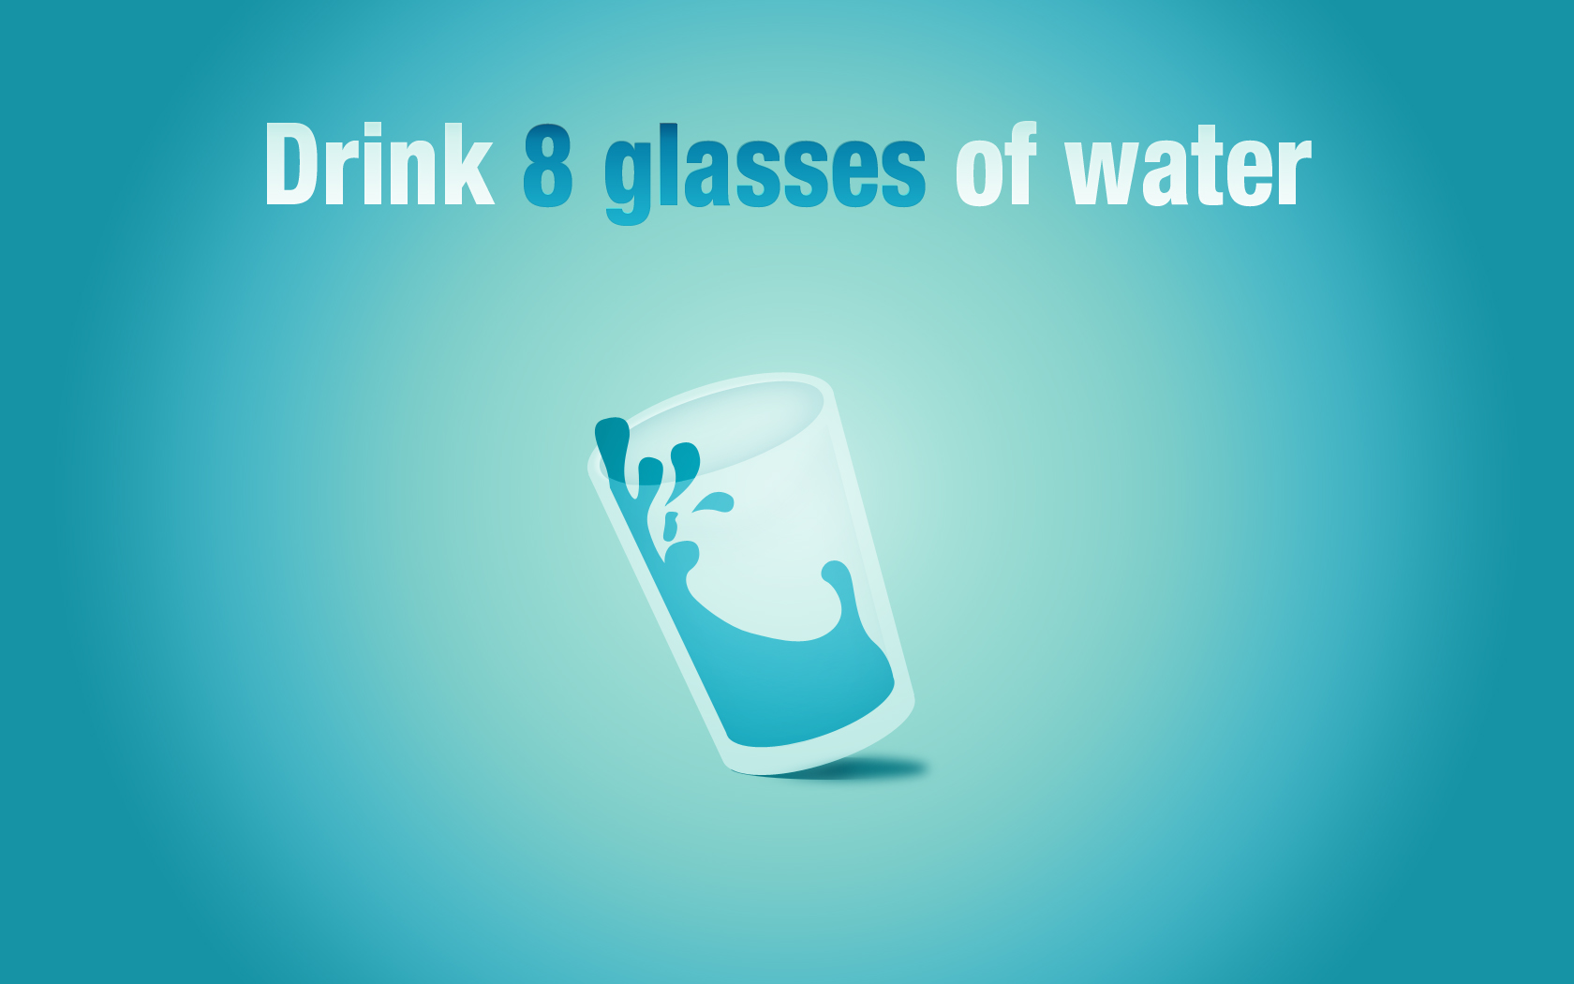

Slide 14
DRINK WATER
Our bodies are made mostly of water, but each day we loose a lot of it, so we need to rehydrate
It it the best and most natural cleanser of our body – it flushes the toxines out of our system
It gives you energy
Your skin is better
Your mood is better
The best times to drink water – after waking up to activate your organs, before a meal helps with digestion (after a meal is bad)

Slide 15
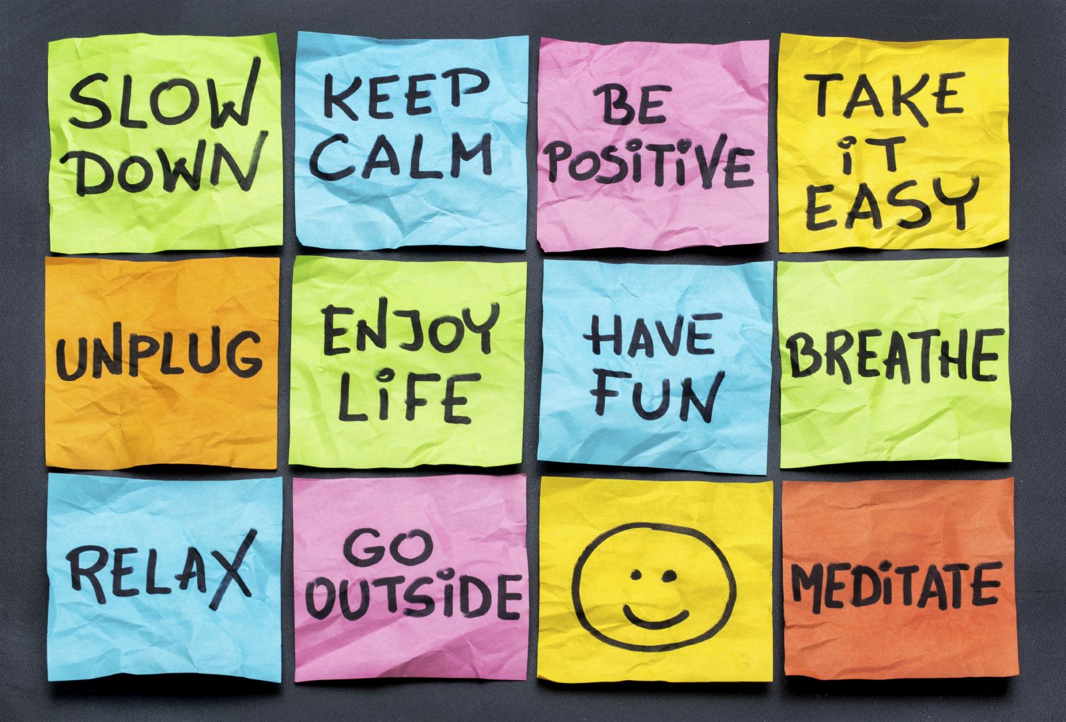

Slide 16
REDUCE STRESS
Stress is bad for your health
Always have some time to do things that help you calm down and feel good, even if you’re really busy
Start planning your time – keeping a schedule can help you with organizing the things you need to do and find time for the things you want to do
Try finding new ways to unplug and relax - we’re all different and a quiet walk in the wood doesn’t work for everyone ;)

Slide 17


Slide 18
EXPRESS YOUR FEELINGS
Don’t keep things bottled up inside – they will eat you alive
Not expressing you feelings causes stress you might not even be aware of
You don’t have to start expressing your feelings in front of everyone – admitting the truth to yourself can help you deal
Find something that gives you an outlet – art, exercise, talking to friends or watching a TV drama

Slide 19
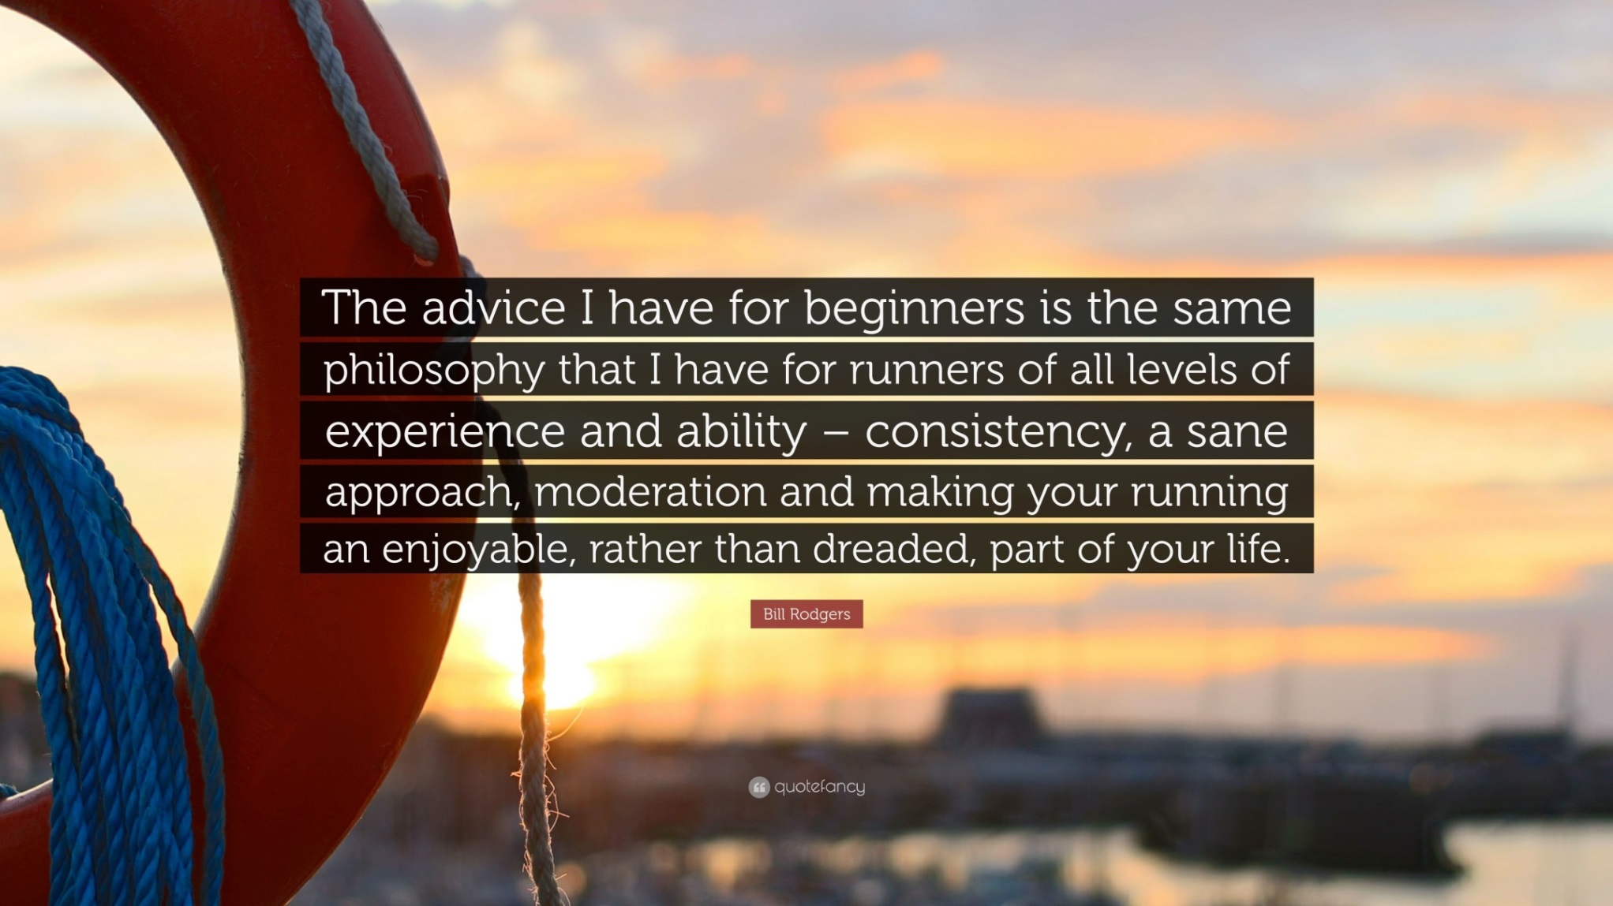

Slide 20
CONSISTENCY AND MODERATION
The biggest step is to start, but to make a change you have to continue
Everything can be good for you, if there is not too much of it, just as everything can be bad, if you overdo it!

Slide 21
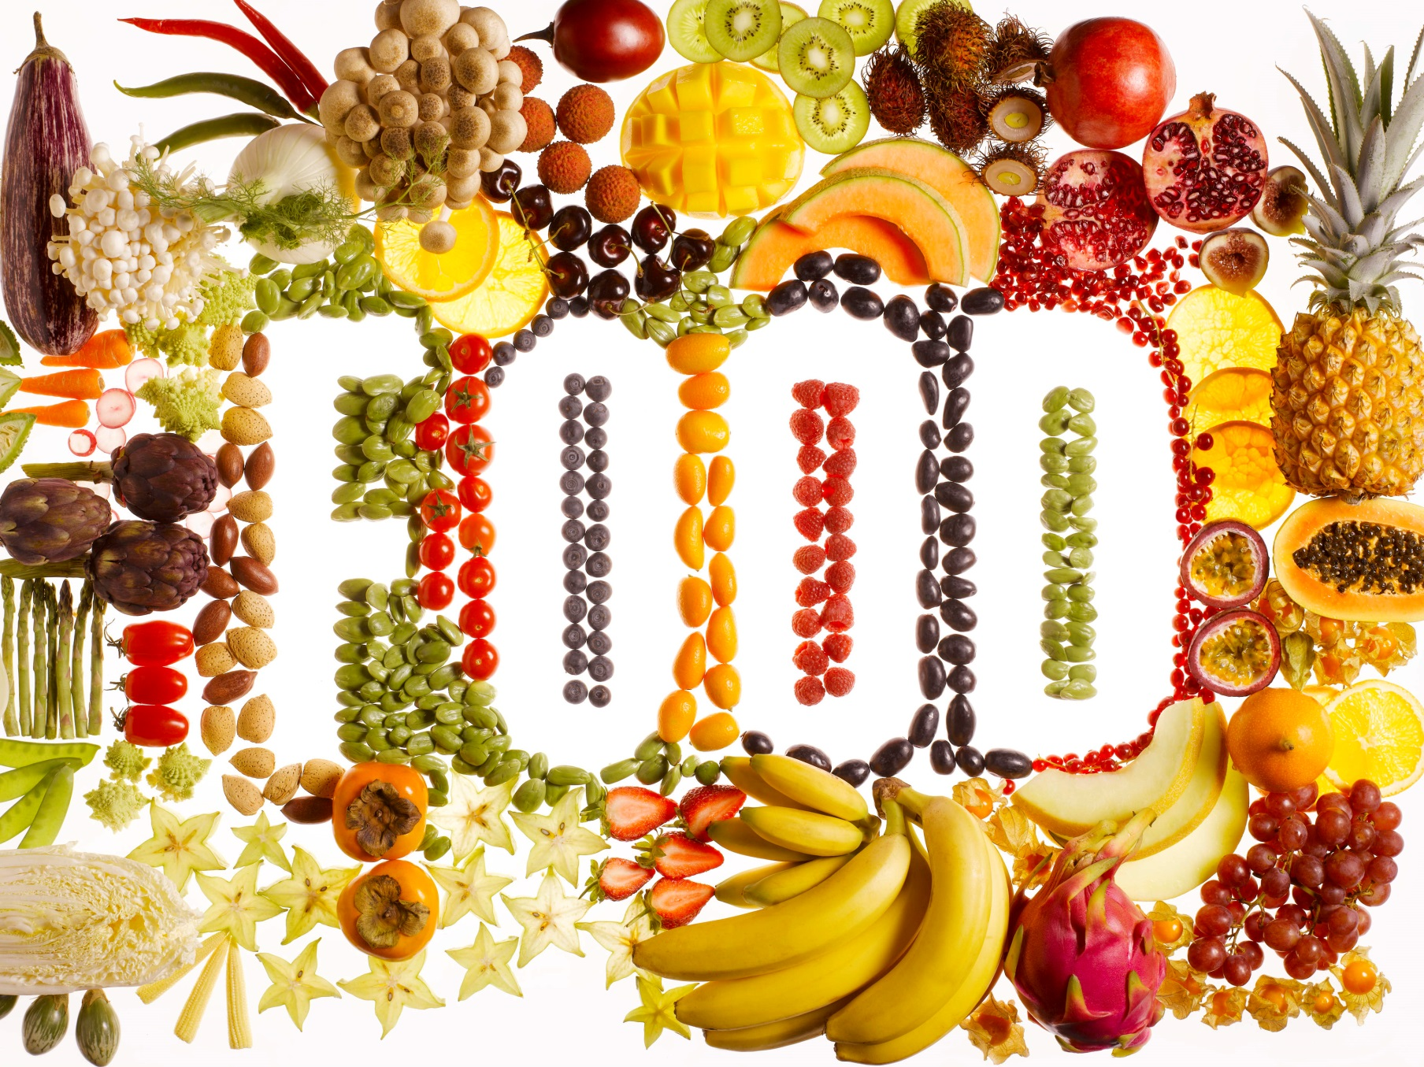

Slide 22
EAT HEALTHY FOOD
Don’t overeat
Eat balanced meals – include a lot of fresh fruit, vegetables, nuts, whole grains and lean meat (fish and poultry)
Eat slowly – let your stomach digest the food – you will eat less
Avoid artificial sweeteners, colours, hidden sugars or excessive fat
Your brain remembers what made it feel good but also what gave it quick energy – if you skip meals, you start craving sweets, soft drinks and junk food

Slide 23
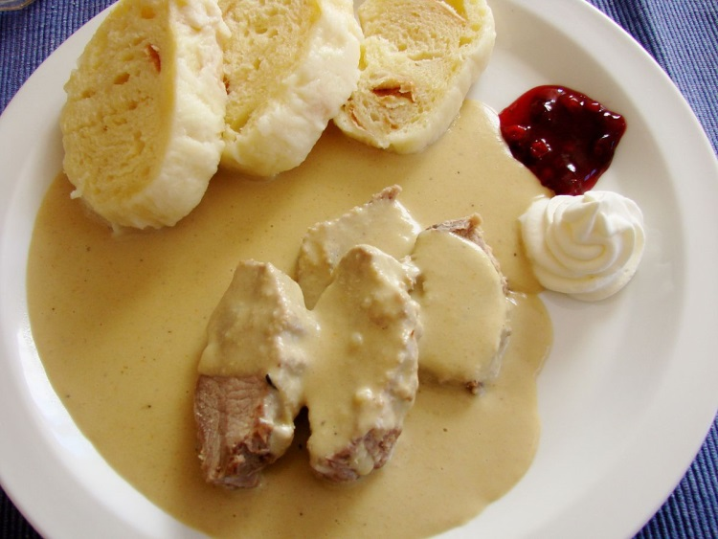
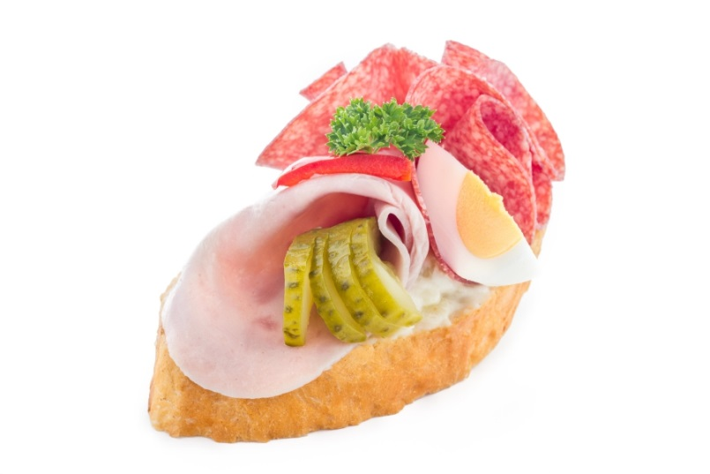
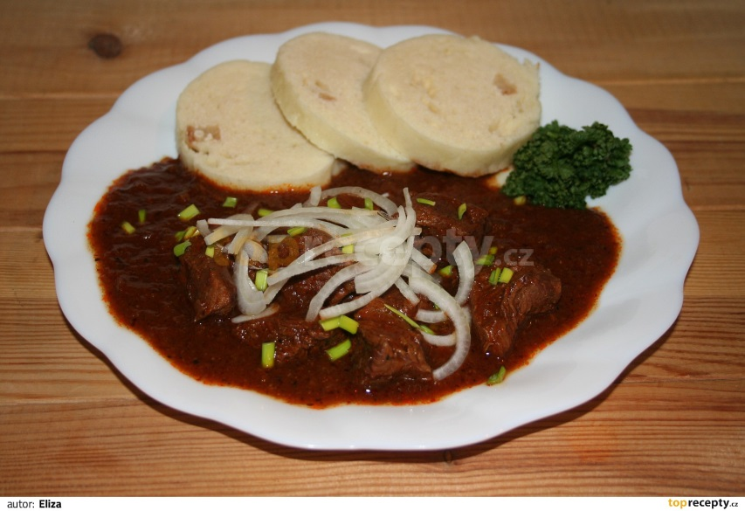
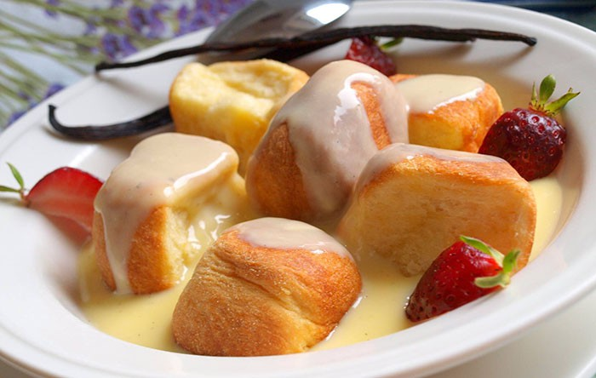
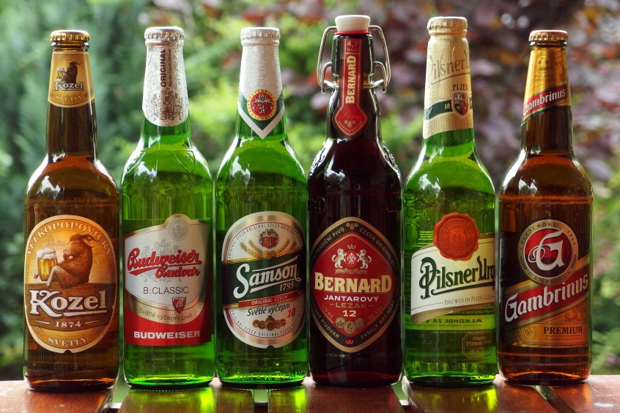
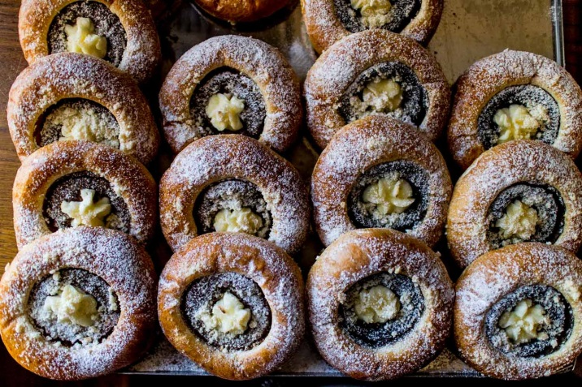
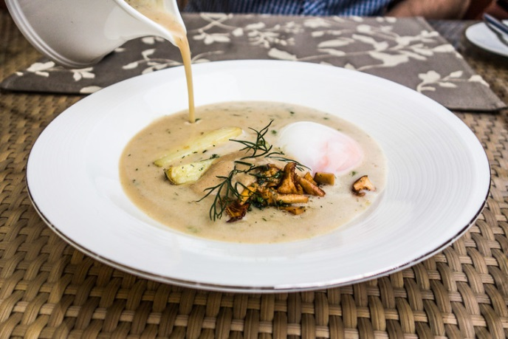
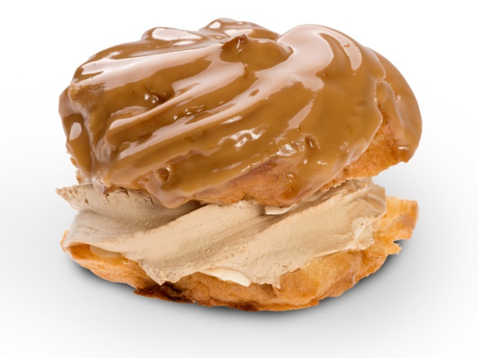
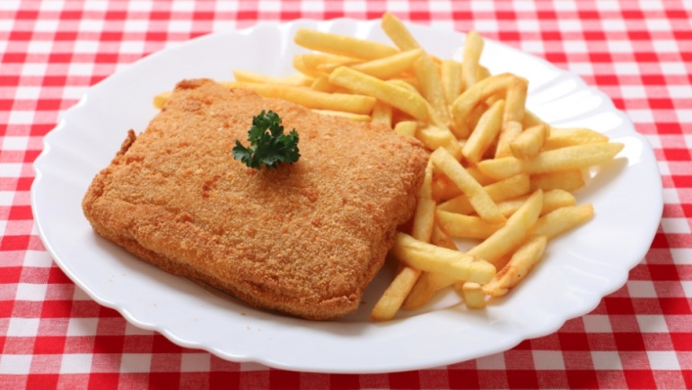

Slide 24
TRADITIONAL CZECH FOOD
It’s full of cream, red meat, white flour, sugar…
What you usually won’t find is fresh fruit and vegetables
But - It’s difficult for us to eat healthy food, because our traditional food is so yummy!
Czech food featured on the previous slide:
Main meals: Sirloin beef with cream sauce and duplings, Gulash, Fried cheese with chips
Soup: Dill soup – Kulajda
Sweet meals: sweet yeast dough buns with vanilla cream, kolaches
Desserts and fingerfood: Vetrnik pastry, open sandwiches
The biggest problem of them all: Czech beer!

Slide 25
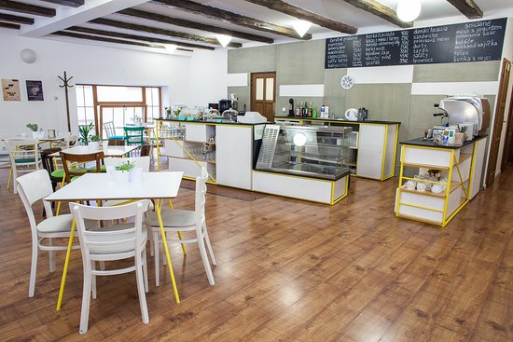

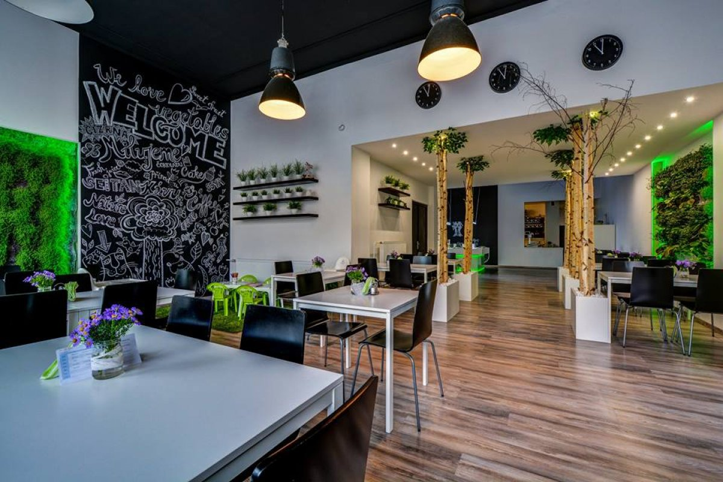
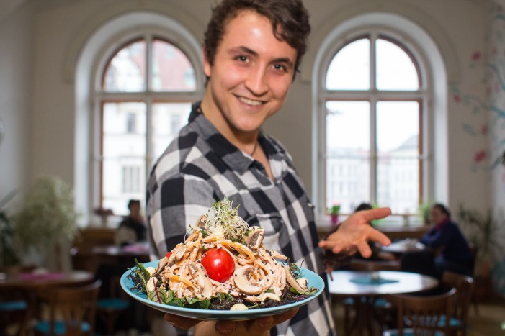
BUT…
We also have a lot of modern bistros and restaurants that focus on vegetarian, vegan or raw food

Slide 26
Sources
bad habits: askmesuccess.com
regular check up: www.gablessedationdentistry.com
sleep: http://lawrenceparkhealth.com/faq-best-way-sleep/
exercise: www.today.com
healthy food: www.health.com
breakfast: popsugar.com
drink water: liesjuh.deviantart.com
reduce stress: www.health.harvard.edu
express yourself: bozed.deviantart.com
moderation: quotefancy.com
article https://www.livestrong.com/article/375751-what-should-or-shouldnt-i-do-to-be-fit-healthy/
joke https://www.reddit.com/r/comics/comments/4jduzm/adopting_a_healthy_lifestyle_oc/

